Slide 1

Course Duration: 38hrs
AWS Solution Architect
Training Overview
Trainer Name: Parag Jain
Experience: 7+ Years

Slide 2


Trainer Profile:
AWS Certified Solutions Architect
Hortonworks Data Platform Certified Developer for Apache Hadoop
Experience in designing (Architect) cloud based big data Analytics product R&D, scalable, serverless data processing pipelines [Spark, Python, AWS, ML].
Working on building ML platform enabling Data Scientist to create, build, train and deploy Machine Learning Model on cloud
Build Serverless Solution to process 100s GB of Data, in less than 1 hour

Slide 3

Overview of the complete Syllabus:
Domain 1: Design Resilient Architectures
1.1 Design a multi-tier architecture solution
1.2 Design highly available and/or fault-tolerant architectures
1.3 Design decoupling mechanisms using AWS services
1.4 Choose appropriate resilient storage
Domain 2: Design High-Performing Architectures
2.1 Identify elastic and scalable compute solutions for a workload
2.2 Select high-performing and scalable storage solutions for a workload
2.3 Select high-performing networking solutions for a workload
2.4 Choose high-performing database solutions for a workload
Domain 3: Design Secure Applications and Architectures
3.1 Design secure access to AWS resources
3.2 Design secure application tiers
3.3 Select appropriate data security options
Domain 4: Design Cost-Optimized Architectures
4.1 Identify cost-effective storage solutions
4.2 Identify cost-effective compute and database services
4.3 Design cost-optimized network architectures

Slide 4
Title : Get started
Cloud Vs On-Premise
AWS Silent Features
AWS Product Fundamentals
Importance of Cloud Technology
Advantages & Disadvantages of cloud
Differentiator from other parallel technologies in the market
Job Opportunities
How long the technology in the market
Future of technology for Next 5 to 10 years
Brief About Certifications

Slide 5
Title : Cloud Vs On-Premise
Cloud | On-Premise
Anywhere and anytime access | Total Cost of Ownership
Affordable | Complete control
Predictable costs | Uptime-not rely on internet connectivity
High levels of security | One time costs
Quick deployment
Scalability
Lower energy costs
Less capital expenditure

Slide 6
Title : AWS Silent Features
Resilient Architectures
High-Performing Architectures
Secure Applications and Architectures
Cost-Optimized Architectures

Slide 7
Title : AWS Product Fundamentals
Storage: S3, glacier, EFS, EBS, etc
User and access management : IAM
Computation : EC2, EMR, ECS, Lambda, Athena, Glue, etc
Network and security: VPC, Route53,
Databases: MySql, Oracle, RedShift, DynamoDB, Aurora

Slide 8
Importance of Cloud Technology
Cost Savings
Security
Flexibility
Mobility
Insight
Increased Collaboration
Quality Control
Disaster Recovery
Loss Prevention
Automatic Software Updates
Competitive Edge
Sustainability

Slide 9

Advantages & Disadvantages of cloud
Advantages | Disadvantages
Cost Savings | Performance Can Vary(share resources)
High Speed | Technical Issues(outage)
Back-up and restore data | Security Threat
Reliability | Internet Connectivity
Unlimited storage capacity | Lower/limited Bandwidth between servers
Quick Deployment | Lacks of Support
On-Demand Compute

Slide 10
Differentiator from other parallel technologies in the market
It is a market that has been dominated by AWS since day one, when it entered the sector in 2006.
Now, Synergy Research Group's figures for Q3 2019 have AWS as the clear market leader globally for public IaaS and PaaS market share at 33 percent, followed by Microsoft at 16 percent, Google at 8 percent and Alibaba at 5 percent
For AWS, the key strength for the market leader continues to be the breadth and depth of its services, with more than 175 across compute, storage, database, analytics, networking, mobile, developer tools, management tools, IoT, security and enterprise applications, at last count.
AWS signaled its first serious move into hybrid deployments at its re:invent conference in 2018 with the launch of Outposts, a fully managed service where the vendor delivers pre-configured racks to your premises, where AWS services can be run as though it were in their data center.

Slide 11

Job Opportunities
$146,350(50-60L) is the median salary for cloud computing professionals in 2018 – Forbes
There are 50,248 cloud computing positions available in the U.S. today available from 3,701 employers and 101,913 open positions worldwide today - Forbes
From October 2015 to October 2019, the share of job postings in that time period increased for AWS by 232.06 percent

Slide 12

How long AWS in the market
2003: In 2003, Chris Pinkham and Benjamin Black presented a paper on how Amazon's own internal infrastructure should look like
2004: SQS stands for "Simple Queue Service" was officially launched in 2004
2006: AWS (Amazon Web Services) was officially launched.
2007: In 2007, over 180,000 developers had signed up for the AWS.
2010: In 2010, amazon.com retail web services were moved to the AWS
2012: First re:invent conference occurred in which new products were launched
2013: In 2013, certifications were launched. AWS started a certifications program for software engineers who had expertise in cloud computing.
2014: AWS committed to achieve 100% renewable energy usage for its global footprint.
2015: AWS breaks its revenue and reaches to $6 Billion USD per annum. The revenue was growing 90% every year.
2016: By 2016, revenue doubled and reached $13Billion USD per annum.
2017: In 2017, AWS re: invent releases a host of Artificial Intelligence Services due to which revenue of AWS doubled and reached $27 Billion USD per annum.
2018: In 2018, AWS launched a Machine Learning Specialty Certs. It heavily focused on automating Artificial Intelligence and Machine learning.

Slide 13

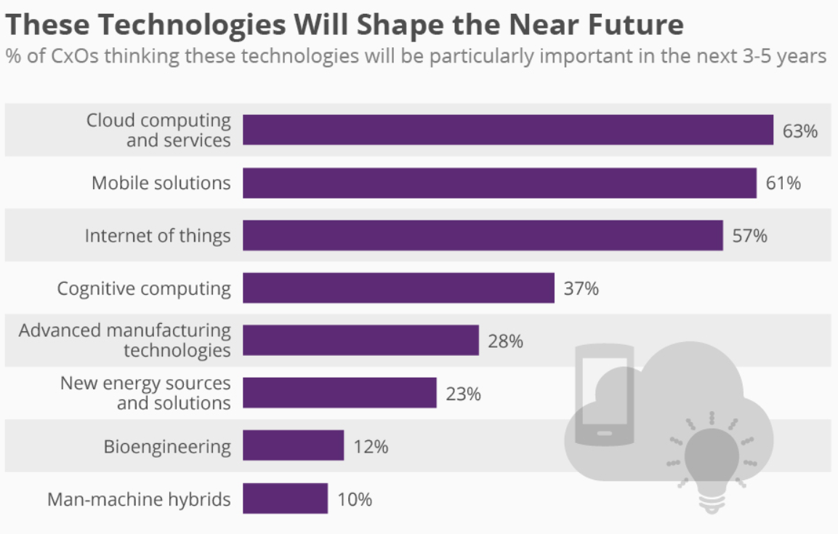
Future of technology for Next 5 to 10 years

Slide 14
Similar competitors of that particular technology
Microsoft Azure
Google
IBM
Oracle

Slide 15
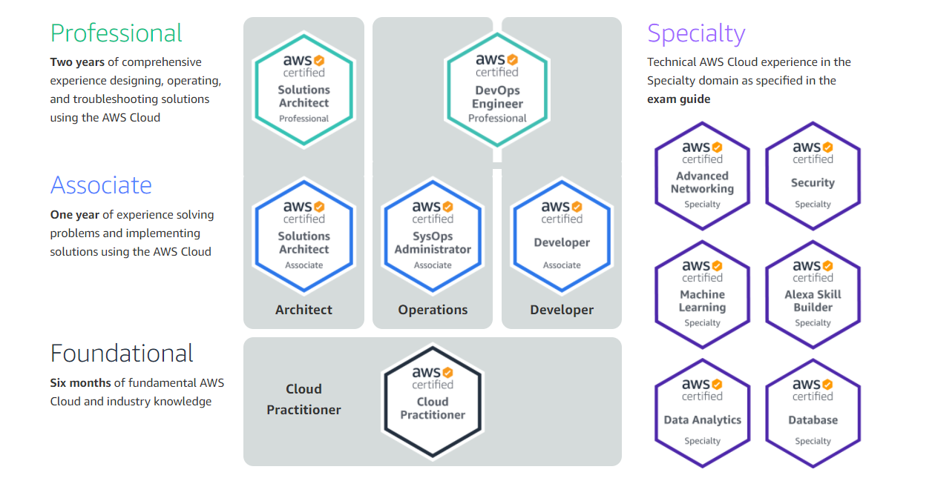
Brief About Certifications

Slide 16

Brief About Certifications…. Conti…
Benefit:
Gain an appreciation for your efforts
Display your commitment levels
Chances to expand professional network
Bring in more projects.
Opportunity to become a Subject Matter Expert
A better paycheck
Where we can give the Certifications
https://aws.amazon.com/certification/
https://aws.amazon.com/certification/certified-solutions-architect-associate/

Slide 17

FAQs
What is an EIP?
What is CloudFront?
What is meant by Edge location?
What is the VPC peering connection?
What are NAT gateways?
Explain about DynamoDB?
What is difference between USER, ROLE and Policy?
How is stopping and terminating an instance different from each other?
Can S3 be used with EC2 instances, if yes, how?
What happens to my backups and DB Snapshots if I delete my DB Instance?
What is the difference between Scalability and Elasticity?
When should I use a Classic Load Balancer and when should I use an Application load balancer?
Explain the various storage classes available in S3?
What is subnet?
What is AWS CloudTrail and AWS CloudWatch?
Explain about AWS Lambda.
What is the security group and NACL?
List the default tables that we get when we create AWS VPC

Slide 18
Thank you

